Slide 1
OT Security vs IoT Security

Slide 2
IT vs OT - Four Core Differences
1. Enterprise vs Industry
The two technologies operate in different environments and serve different purposes.
IT environments involve common environments and solutions (the cloud, servers, firewalls, antivirus, etc.), they communicate over known protocols (HTTP, SSH, RDP), and so forth.
OT includes completely different components that can be found primarily in industrial environments. \
These components are often screenless (machinery, PLCs), they communicate over industrial protocols that are never seen on IT networks (e.g., Modbus, Ethernet/IP, Profinet),
they lack security tools (firewalls, antivirus), and they are even programmed differently than “normal” computers.

Slide 3
IT vs OT - Four Core Differences
2. IT Prioritizes Confidentiality, OT Focuses on Safety
Because IT primarily involves storage, retrieval, manipulation, and transmission of digital information, data and confidentiality are a top concern.
IT security is crucial in every organization in order to keep its data secure and under control.
In OT, the safety and availability of equipment and processes dominate.
Dealing with physical systems that must maintain stable values, such as temperature and RPM, requires meticulous control.
Lack of control can lead to extensive financial losses due to temporary halts in production or even result in direct physical harm.
For example, a ransomware attack that blocks access to operations can lead to a few days of inactivity where each day may be worth millions of dollars.

Slide 4
IT vs OT - Four Core Differences
3. IT Incidents are More Frequent, OT Incidents are More DestructiveWhile OT incidents may lead to more destructive outcomes, IT has more ways in which it can be manipulated.
Simply put, IT has more touchpoints with the internet.
These gateways pose higher security risks because each one can potentially be a hack waiting to happen.
OT has a lower number of gateways, making it comparatively safer.
However, the potential magnitude of compromised physical equipment tends to be greater than that of a data breach.
Even slight OT cyber-incidents can lead to huge financial losses and have damaging ramifications that can affect the general population, such as water contamination and power outages.

Slide 5
IT vs OT - Four Core Differences
4. Security Patching - Every Week vs Every Ten Years
IT components advance so fast and have relatively short life spans, that a network can look completely different only several years apart.
In fact, IT security updates are so frequent that many IT vendors have a designated "update day of the week" or "Patch Tuesday".
Security patching does not work the same way in OT.
Since patching OT components requires complete shutdowns that halts production, vendors running OT networks rarely patch their components, if at all.
Since OT components are rarely updated, they may have many more public vulnerabilities when compared to IT computers.
This means that the probability of a successful exploit on an OT system is exponentially higher than on an IT system.

Slide 6
OT vulnerabilities can arise due to some of the following issues:
1. Lack of segmentation:
If OT networks are not properly segmented, an attacker who gains access to one part of the network has the potential to move laterally through the entire OT environment.
2. Outdated software:
In critical infrastructure organizations, it is common to have a mix of new and legacy devices in the environment.
These legacy devices are many times running on outdated software that is no longer supported — leading to CVEs and other vulnerabilities.

Slide 7
OT vulnerabilities can arise due to some of the following issues:
3. Lack of secure remote access (SRA):
If remote access to OT by internal personnel and/or third-parties such as maintenance technicians or original equipment manufacturers (OEMs) is not properly controlled, monitored, and secured, attackers can exploit these conditions to gain unauthorized access over the system.
4. Poor password hygiene:
Weak passwords that can be easily guessed or are used across various personal and professional platforms make it simple for hackers to breach OT systems.
The challenges listed above can result in a wide range of consequences including financial losses, production downtime, environmental damages, and hazards to human health and safety.
That is why it is crucial to understand that each OT system is unique and has their own specific vulnerabilities that require identification and remediation.

Slide 8
Need of OT Penetration Testing
OT penetration testing is a process that involves simulating a cyber attack on an OT environment / Industrial Control System (ICS) to identify vulnerabilities and weaknesses in the system’s security.
This process is critical in identifying potential entry points for malicious hackers and protecting against attacks.
To perform an OT Penetration Test, a penetration tester will typically use non-intrusive penetration testing techniques to identify potential vulnerabilities in the OT network.
OT Penetration Testing can also involve more intrusive techniques like attempting to exploit vulnerabilities discovered during the initial assessment.
This allows the penetration tester to demonstrate the potential impact of an attack and provide recommendations for improving the security of the OT environment

Slide 9
Need of OT Penetration Testing
Organisations should conduct regular Penetration Testing of their OT environment for the following key reasons:
To identify weaknesses in infrastructure (hardware), application (software) and people (process) in order to develop remedial controls;
To ensure implemented security controls are effective, this provides assurance to security teams, senior management and stakeholders that security posture is maintained;
To discover new bugs in existing software as patching and updates can fix existing vulnerabilities, but they can also introduce new vulnerabilities;
When appropriately performed, OT Penetration Testing goes beyond merely stopping malicious threat actors from unauthorised access to a company’s OT assets and environment. It creates real-world scenarios that show organisations how well their current defences would fare when confronted with a full-scale cyber attack

Slide 10
Steps Involved
5 Steps for OT Penetration Testing
Ensure the consultant has the necessary OT experience and knowledge to perform these types of engagements.
Establish explicit ground rules for interaction and refrain from using active, potentially dangerous penetration testing methods on live networks
Know your environment and engage with an OT/SCADA subject matter expert
Perform security testing on non-production systems where at all possible
Security testing should employ real world attack scenarios to ensure maximum value to your cyber security strategy.

Slide 11
Types of Tests
Internal Penetration Test: Imitates an insider threat and identifies how an attacker with internal access may compromise or damage the network, systems, or data.
External Penetration Test: Designed to discover and exploit vulnerabilities in hosts accessible via networks external of the OT environment (e.g. IT, Internet).
Application Penetration Test: Simulates attacks on a system in an attempt to gain unauthorised access.
Wireless Penetration Test: Identifies vulnerabilities in your wireless infrastructure.

Slide 12
Documentation
The results of the assessment activities are documented within a formalised report that includes:
Assessment methodology;
Executive summary;
Detailed technical analysis and remediation recommendations;
Identified security vulnerabilities classified according to potential impact and the likelihood of exploitation.

Slide 13
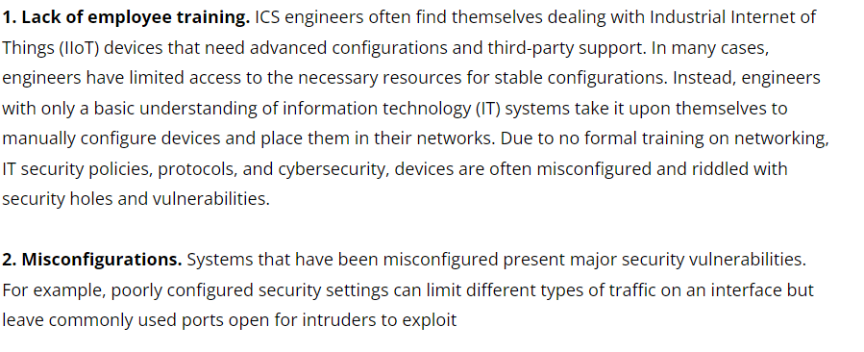
Vulnerability of ICS/SCADA

Slide 14
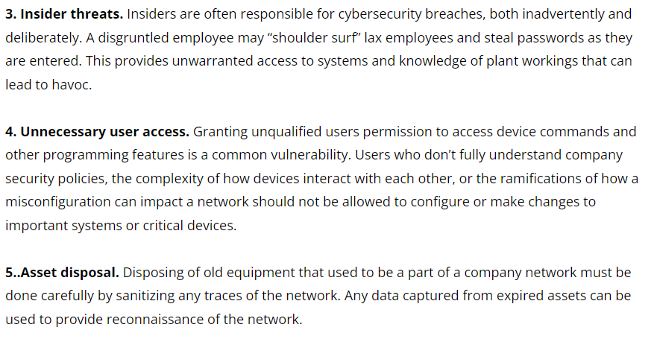
Vulnerability of ICS/SCADA

Slide 15
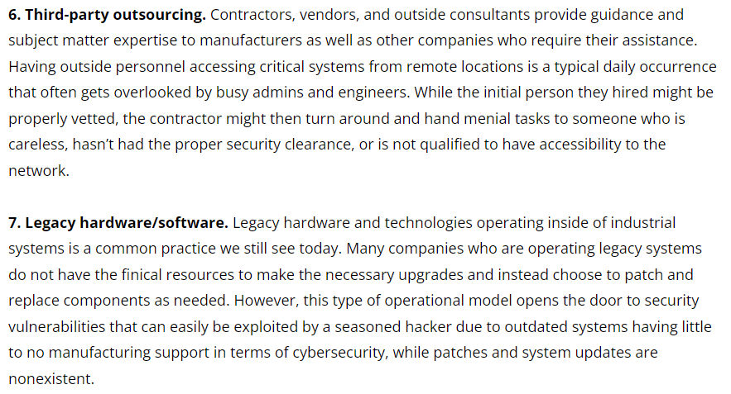
Vulnerability of ICS/SCADA

Slide 16
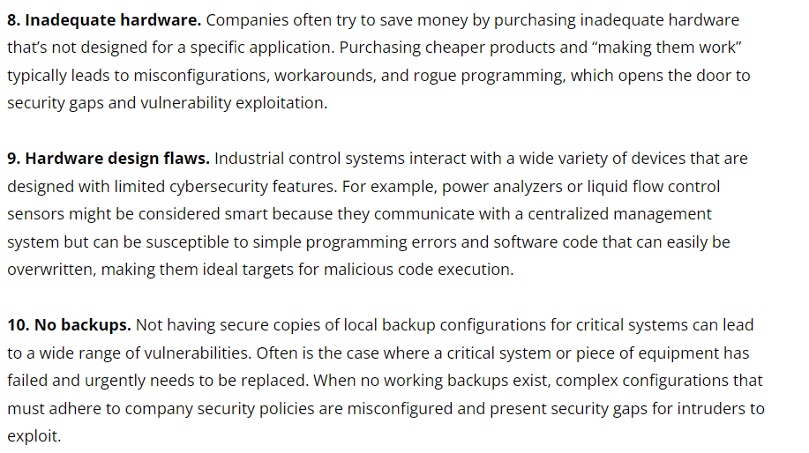
Vulnerability of ICS/SCADA

Slide 17
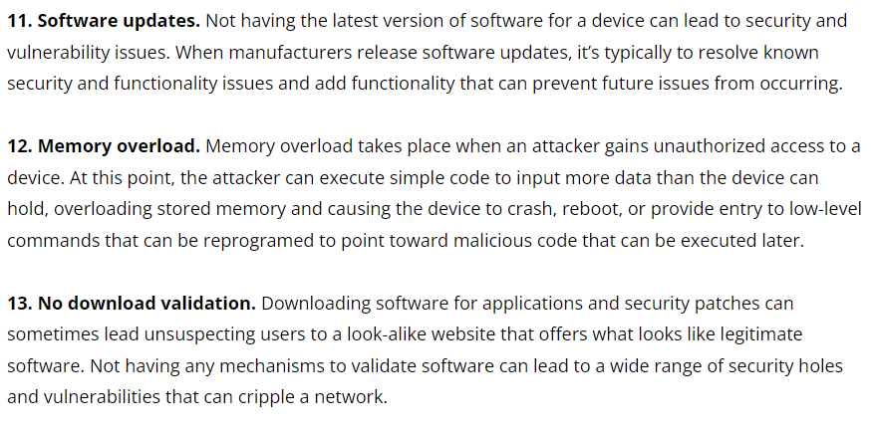
Vulnerability of ICS/SCADA

Slide 18
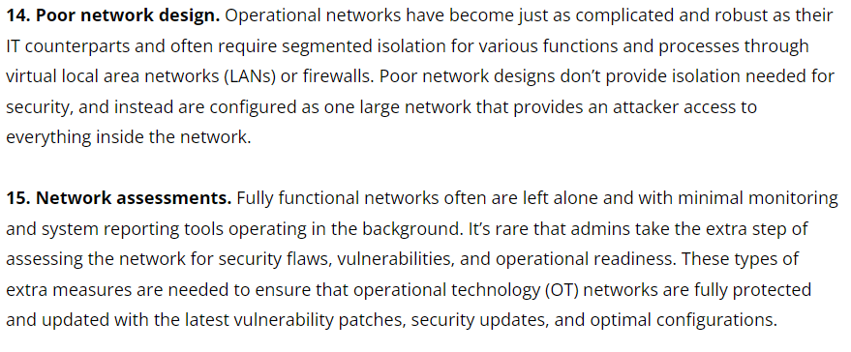
Vulnerability of ICS/SCADA

Slide 19
Asset Identification
Asset identification was the top concern among respondents in the SANS 2019 State of OT/ICS Cybersecurity Survey.
Despite this priority—and, in many organizations, being supported by significant resourcing—asset inventories continue to be unreliable and incomplete, compounding problems during both emergency and routine events.
Motivations for performing asset identification can vary from organization to organization, In some cases, regulatory requirements such as NERC-CIP-002 drive identification efforts, while ensuring appropriate depreciation schedules or looking for hidden operational costs drives efforts

Slide 20
Asset Identification
Regardless of the motivation, asset identification comes in many forms
Simple as a walk-down inventory stored as a spreadsheet maintained by the operations team
Complex as continuous automatic discovery scanning and network change management solutions

Slide 21
Asset Identification
Generally, asset identification techniques fall into four categories:
• Physical inspection
• Passive discovery
• Configuration analysis
• Active discovery

Slide 22
Asset Identification
Physical Inspection
Physical inspection entails tracing every piece of fiber, ethernet, serial cable and wire throughout your process facility to validate what systems are connected.
If performed properly, physical inspection typically results in gathering the most comprehensive data and uncovers assets you would not be able to identify using other means.

Slide 23
Asset Identification
To get started, begin at the most upstream connection point on your network—likely your corporate network firewall—and trace every wire as it splits off various in-line devices.
Physical inspection is particularly effective for initial asset inventory development.
However, it does not have the scalable benefits and ease of automated updates found in passive or active discovery, nor the additional context available in configuration analysis. Physical inspection is extremely labor-intensive, making it the costliest method.
But properly implemented, it can be a great way to build your asset inventory program.

Slide 24
Asset Identification
Passive Discovery
Passive discovery consists of using passive network, wireless and serial monitoring technologies to identify assets communicating in your system.
This technique requires the installation of passive monitoring technologies in your communications system;
Once the technology is installed, it is one of the lowest impact techniques for asset discovery.
It can be left in place not only for continuous monitoring of assets, but also for network communication baselining and monitoring.

Slide 25
Asset Identification
Passive discovery tools are more robust for traditional network technologies and protocols, such as ethernet or TCP/IP, and less robust for industrial protocols, such as Profibus or Modbus.
Passive discovery can be a great tool for identifying assets at Purdue Model Level 2 and above rapidly

Slide 26
Asset Identification
Configuration Analysis
Configuration analysis is a technique that takes existing configuration data from process control systems, networking devices, process diagrams and other configuration sources to create a picture of known assets.
Configuration analysis can be completely passive, similar to passive discovery leveraging static configurations, or more active by leveraging automation to evaluate configurations continually.
Unlike physical inspections, configuration analysis techniques can scale to the entire plant rapidly by leveraging just a few staff hours compiling and normalizing multiple configuration sources,

Slide 27
Asset Identification
Active Discovery
Active discovery is a technique that uses active network communications to identify devices in the environment.
These probes can be generic to the communications technology, such as an ICMP ping, or specific to the protocol, such as a Modbus unit identifier scan.
Active discovery is able to identify devices that are otherwise dormant on a network.
It might, however, miss devices that are configured to respond only under specific circumstances, such as a specific Master ID

Slide 28
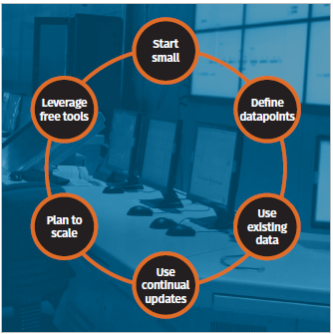
Starting Asset Identification Program

Slide 29
Open Source Tool
GRASSMARLIN
GRASSMARLIN6 is an open source passive discovery tool that can map ICS into a visual or exportable topology map.
GRASSMARLIN can analyze live network tap, span traffic or existing packet captures and attempts to perform device fingerprinting, network communication flow fingerprinting and other passive analysis techniques.
CyberLens
CyberLens is a free, passive discovery ICS network visibility tool.
Performs deep packet inspection on a handful of ICS protocols from live or offline captures
Can identify I/O and protocol commands of IP-based communication to build and map an asset inventory.
Identifies ICS assets by passive discovery and inference of control data flows based on deep packet inspection.

